Slide 1
Lab 4 Calibrating a function generator
By Daksh Khandelwal

Slide 2
Objective and Experiment
Objective - To determine the accuracy of a BK precision 4011A function generator across multiple frequency ranges.
Experiment - generate 1 khz and 5 khz sine waves.
Compare two measurement techniques:
The tektronix oscilloscope's built-in, real-time FFT.
An offline fft calculated in python using the oscilloscope's raw time-domain data.

Slide 3

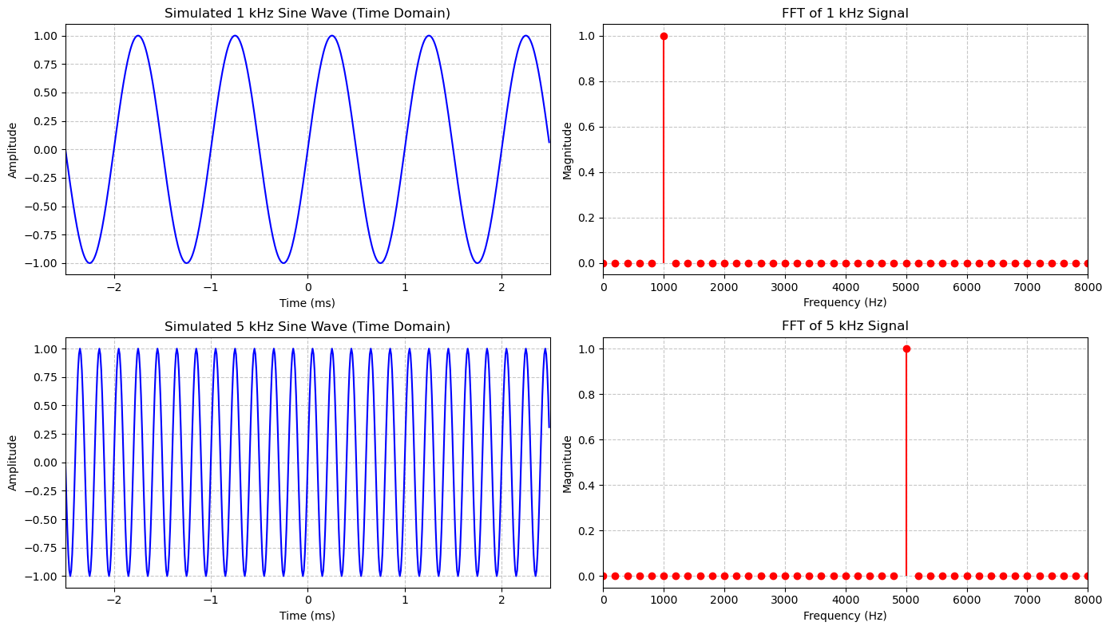

Slide 4

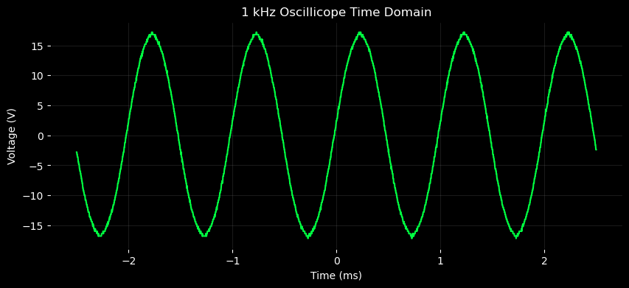
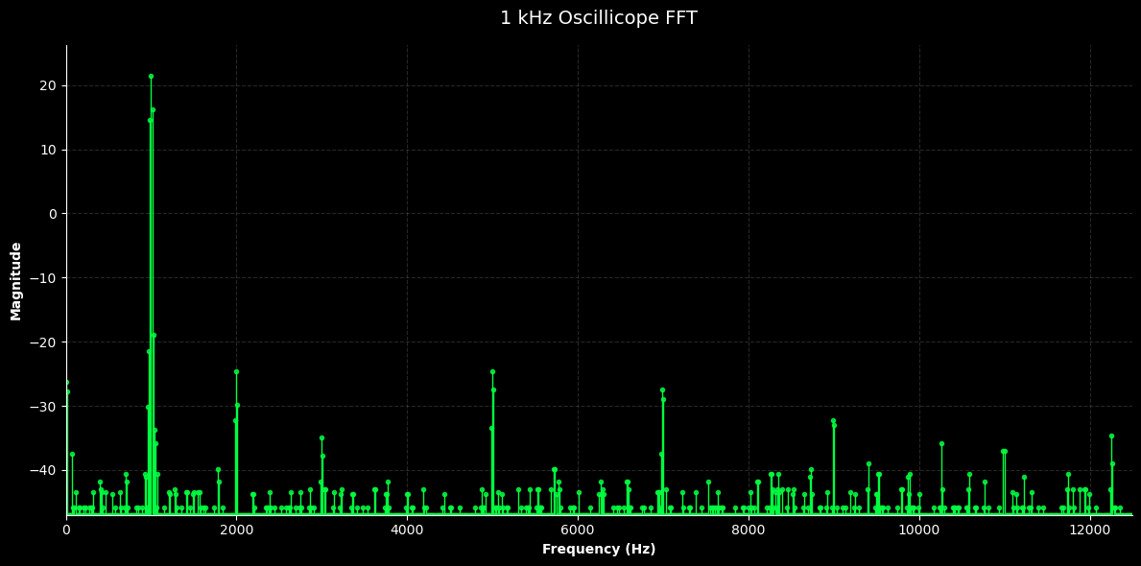
Oscillicope Data
The raw data from the oscilloscope measures harmonics for the 1 kHz sinewave.

Slide 5
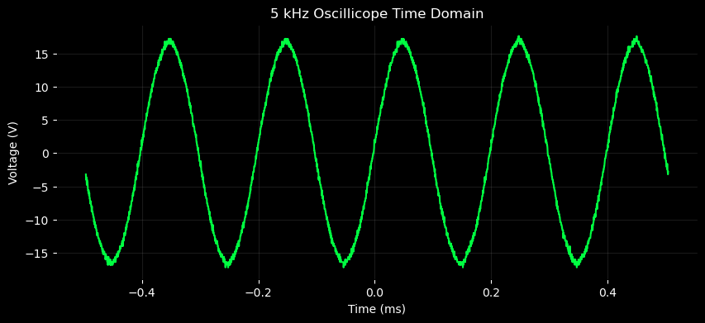

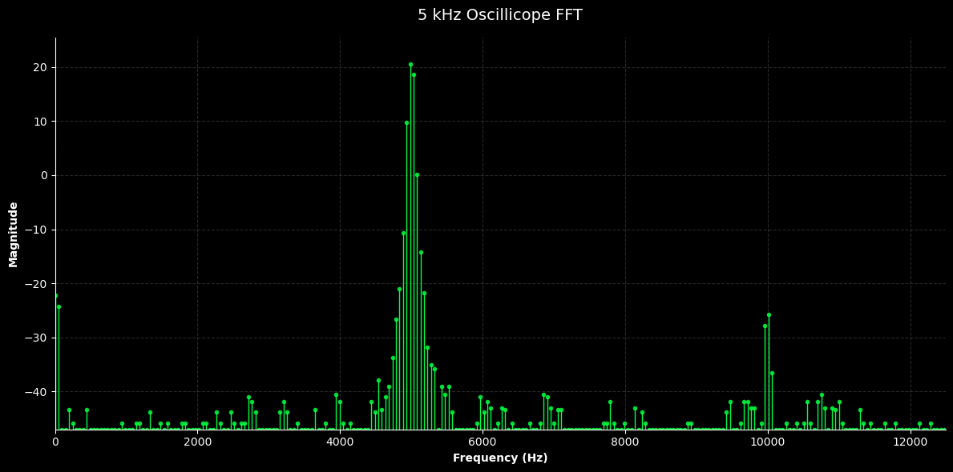
Oscillicope Data
The raw data from the oscilloscope measures harmonics for the 5 kHz sinewave.

Slide 6
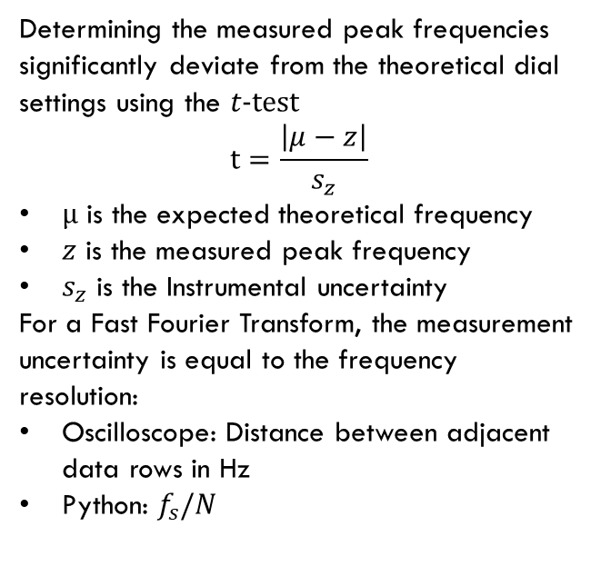
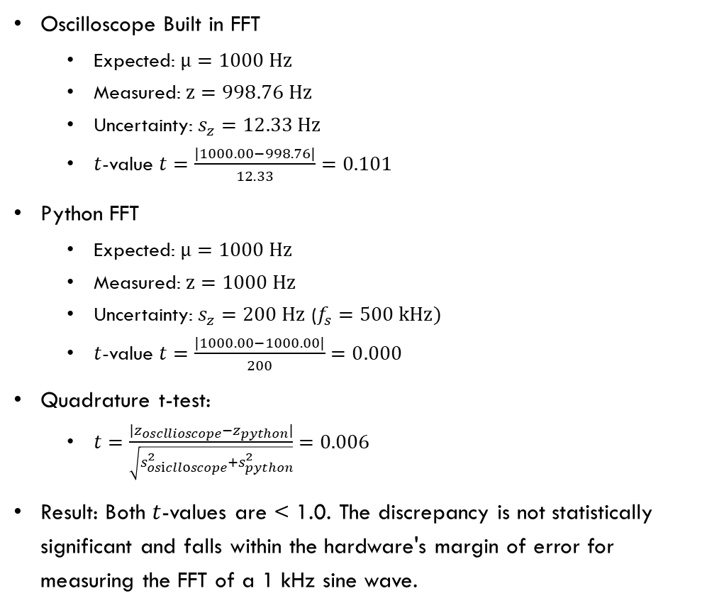
1 kHz Frequency Calibration
Oscilloscope Built in FFT
Expected: $μ=1000 Hz$
Measured: $z=998.76 Hz$
Uncertainty: $s_{z}=12.33 Hz$
$t$-value $t=\frac{\left|1000.00−998.76\right|}{12.33}=0.101$
Python FFT
Expected: $μ=1000 Hz$
Measured: $z=1000 Hz$
Uncertainty: $s_{z}=200 Hz$ ($f_{s}=500 kHz)$
$t$-value $t=\frac{\left|1000.00−1000.00\right|}{200}=0.000$
Quadrature t-test:
$t=\frac{|z_{oscllioscope}−z_{python}|}{\sqrt{s_{osiclloscope}^{2}+s_{python}^{2}}}=0.006$
Result: Both $t$-values are < 1.0. The discrepancy is not statistically significant and falls within the hardware's margin of error for measuring the FFT of a 1 kHz sine wave.
Determining the measured peak frequencies significantly deviate from the theoretical dial settings using the $t-test$
$$t=\frac{\left|μ−z\right|}{s_{z}}$$
$μ$ is the expected theoretical frequency
$z$ is the measured peak frequency
$s_{z}$ is the Instrumental uncertainty
For a Fast Fourier Transform, the measurement uncertainty is equal to the frequency resolution:
Oscilloscope: Distance between adjacent data rows in Hz
Python: $f_{s}/N$

Slide 7
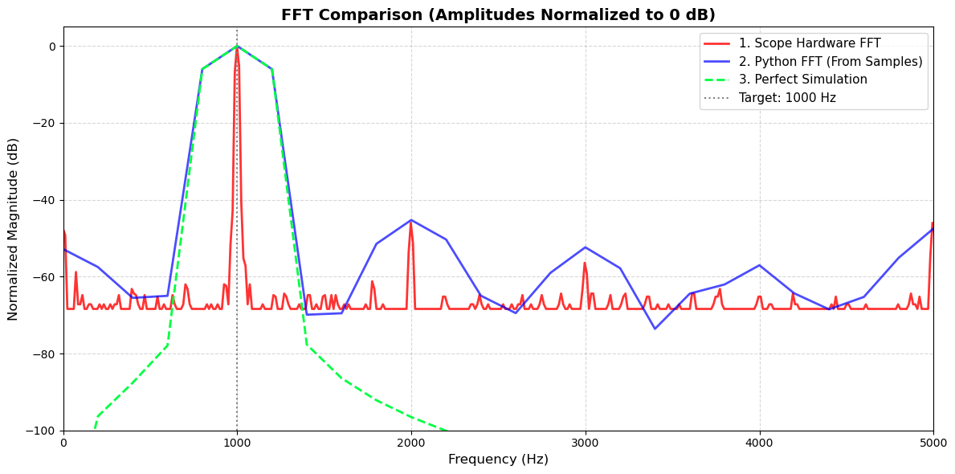

Slide 8
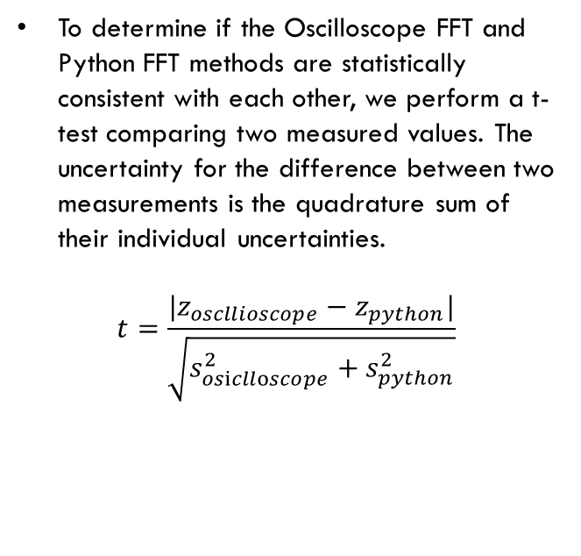
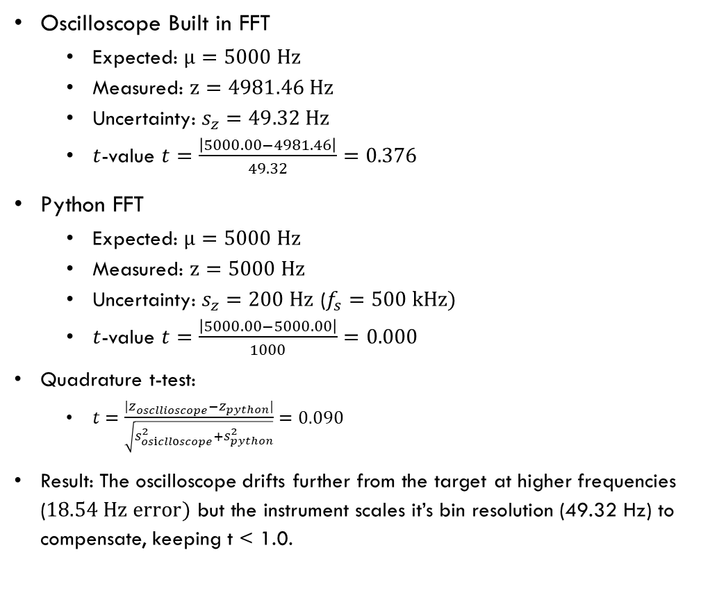
5 kHz Frequency Calibration
Oscilloscope Built in FFT
Expected: $μ=5000 Hz$
Measured: $z=4981.46 Hz$
Uncertainty: $s_{z}=49.32 Hz$
$t$-value $t=\frac{\left|5000.00−4981.46\right|}{49.32}=0.376$
Python FFT
Expected: $μ=5000 Hz$
Measured: $z=5000 Hz$
Uncertainty: $s_{z}=200 Hz$ ($f_{s}=500 kHz)$
$t$-value $t=\frac{\left|5000.00−5000.00\right|}{1000}=0.000$
Quadrature t-test:
$t=\frac{|z_{oscllioscope}−z_{python}|}{\sqrt{s_{osiclloscope}^{2}+s_{python}^{2}}}=0.090$
Result: The oscilloscope drifts further from the target at higher frequencies ($18.54 Hz error)$ but the instrument scales it’s bin resolution (49.32 Hz) to compensate, keeping t < 1.0.
To determine if the Oscilloscope FFT and Python FFT methods are statistically consistent with each other, we perform a t-test comparing two measured values. The uncertainty for the difference between two measurements is the quadrature sum of their individual uncertainties.
$$t=\frac{|z_{oscllioscope}−z_{python}|}{\sqrt{s_{osiclloscope}^{2}+s_{python}^{2}}}$$

Slide 9
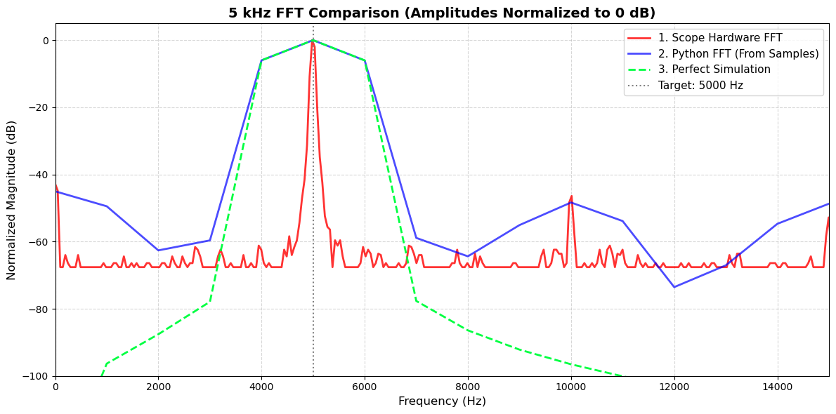

Slide 10

The shape of ffts
Sample rate choice: increasing the sample rate $\left(f_{s}\right)$ alone does not improve frequency resolution, it only increases the maximum frequency range (bandwidth) that can be captured. To improve resolution and achieve narrower, sharper peaks, you must increase the total observation time $(T)$ of the signal.
The visual width of a frequency peak is determined by the size of the frequency bins, which is defined as $Δf = 1/T$. The python fft often appears fatter than a hardware oscilloscope FFT because the total duration of the exported time-domain signal is shorter than the internal processing window of the oscilloscope. This shorter window creates larger frequency bins, causing the signal energy to be distributed over a wider visual range.

Slide 11
Discussion and Comparison
Oscilloscope FFT: Excellent for real-time, high-precision visualization, though it showed a minor (but acceptable) drift of 18.54 Hz at higher frequencies.
Python FFT: Provides a robust offline check. While the peaks are wider due to the 200 Hz bin size, the calculation consistently yielded a t-value of zero.
Summary: The equipment is operating within its specified instrumental uncertainty, and the two measurement methods successfully cross-validate one another.
The BK Precision 4011A was verified across both 1 kHz and 5 kHz ranges. All t-values remained significantly below 1.0, confirming that the function generator’s output is statistically consistent with its dial settings.

